Slide 1
Daham Mustafa
daham.mohammed.mustafa@iais.fraunhofer.de

Slide 2
people or experiences:
Families and may parents:
Who taught me the value of working hard, being determined, and showing kindness since my early years.
supported me in pursuing my education and encouraged me to explore my interests and passions.
My experiences living and working in different settings:
challenged me to think critically and creatively and provided me with opportunities to take on new and exciting projects that helped me grow both personally and professionally.

Slide 3

What make me Special?
Quick learner:
Able to quickly understand and master the required skills to complete the project successfully.
java-generator: Java library containing all classes, properties and enumerations of the Asset Administration Shell (AAS) Metamodel.
RDF, OWL and SHACL.
I am a confident person who can handle problems alone or work well with others in a team to solve challenges effectively.
Failure is a natural part of the learning process, and I am not afraid to fail.
https://joinup.ec.europa.eu/collection/interoperability-test-bed-repository/solution/interoperability-test-bed/news/shacl-shape-validation-your-own-language

Slide 4
important stations
Experiences:
W I have had the opportunity to work in various settings that have shaped my professional and personal development.
Working in refugee camps, providing humanitarian aid.
This experience taught me the value of empathy resilience, and adaptability in challenging environments.
Additionally, working as a coordinator for different organizations.

Slide 5

Influential Factors: What and Who has Shaped Me
Motivation:
My interest in technology and problem-solving has been the driving force behind my development.
I have always been fascinated by the capabilities and potential of artificial intelligence and machine learning.
My supervisor have pushed me to explore and research new topics and expand my knowledge base.
https://edition.cnn.com/2020/06/15/entertainment/spongebob-gay-tweet-trnd/index.html

Slide 6

Insights into Myself: ΓΝΩΘΙ ΣΑΥΤΟΝ
My views:
I am a very detail-oriented person and take pride in producing high-quality work.
I value clear communication and believe it's important to be open and honest with colleagues.
I enjoy collaborating with others.
I am respectful of all individuals regardless of their background, gender and religion.
I am flexible and adaptable and can adjust to changing priorities and circumstances.
Delphic maxims
https://exploringyourmind.com/the-origin-of-the-famous-saying-know-thyself/

Slide 7


Key Milestones in My Life
Prof. Dr.-Ing. Jan-Henrik Haunter
Geoinformation Systems Coordinate Systems
Advanced Algorithms for Geoinformation Systems
Geoinformation Management in Interdisciplinary Research

Slide 8

Motivation for Joining Fraunhofer, Fraunhofer IAIS
leading scientific institutes in the fields of Artificial Intelligence, Machine Learning and Big Data in Germany and Europe.
MP3 audio compression format, the development of energy-efficient LED lighting technology, and the creation of technologies used in advanced manufacturing processes.
I found the working environment is very pleasant.
The team working there was nice and supportive.
https://en.wikipedia.org/wiki/MP3#/media/File:Mp3.svg

Slide 9

My Career Goals and Aspirations at Fraunhofer IAIS
I am hoping to work on projects that have practical applications and can make a positive difference in society.
Focus on applied research and technology transfer, and I am eager to be a part of this effort.
Developing algorithms, automotive technology.
Optimization.
https://peoplecentredexcellence.co.uk/practical-problem-solving-in-lean-organisations/

Slide 10

don't want?
Negative impacts:
I am not interested in working in a role where I am not challenged.
in a place where my skills and knowledge not fully utilized.
Limited opportunities for growth and development.
https://codegym.cc/groups/posts/523-problem-solving-how-to-boost-your-ability-to-solve-programing-tasks-and-challenges

Slide 11
Exploring Preferred Job Roles and Motivations
Roles:
Technical Role:
utilize my expertise in a particular domain to solve complex problems and create innovative solutions.
Research Role:
explore new ideas and concepts, conduct experiments, and analyze data to discover new insights and make meaningful contributions to the scientific community.
interested in opportunities to lead and mentor students.

Slide 12
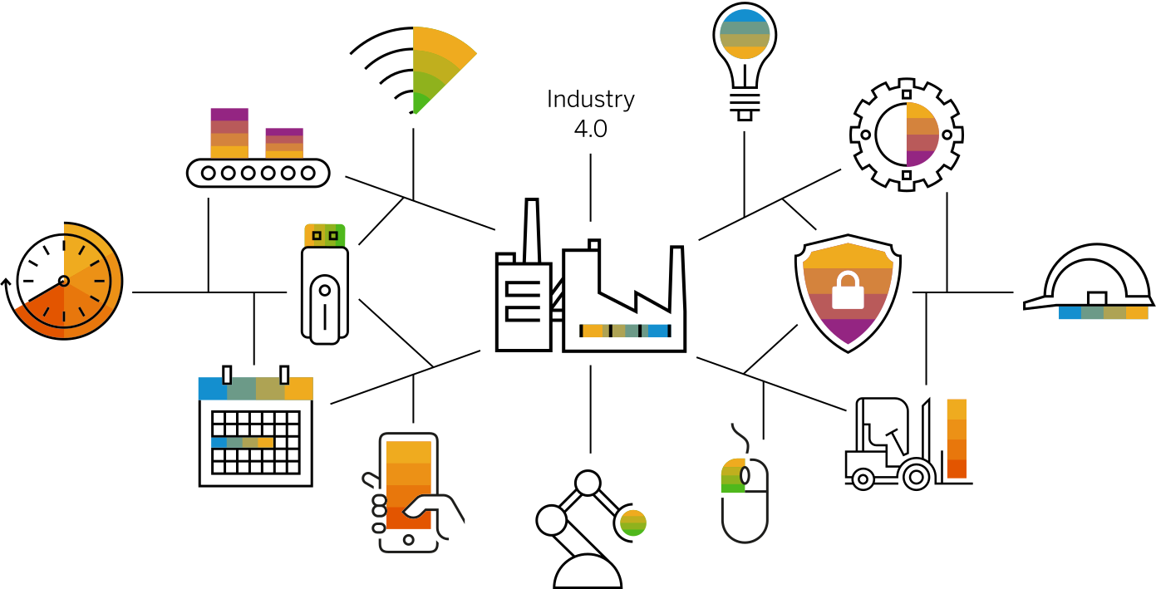
What I want to learn with Fraunhofer IAIS?
Knowledge Graphs and the Semantic Web.
Digital Twin, AAS.
IOT
Big data analysis.
NLP.
https://www.sap.com/germany/insights/what-is-industry-4-0.html

Slide 13

Goals and Dreams to Accomplish
Extending Thesis to Implement Bikeability in the Domain of Knowledge Graph.
‘Safety Index For Bikeability In Urban Environments’.
Developing a bike routing engine.
paper summarizes the work presented in my thesis

Slide 14

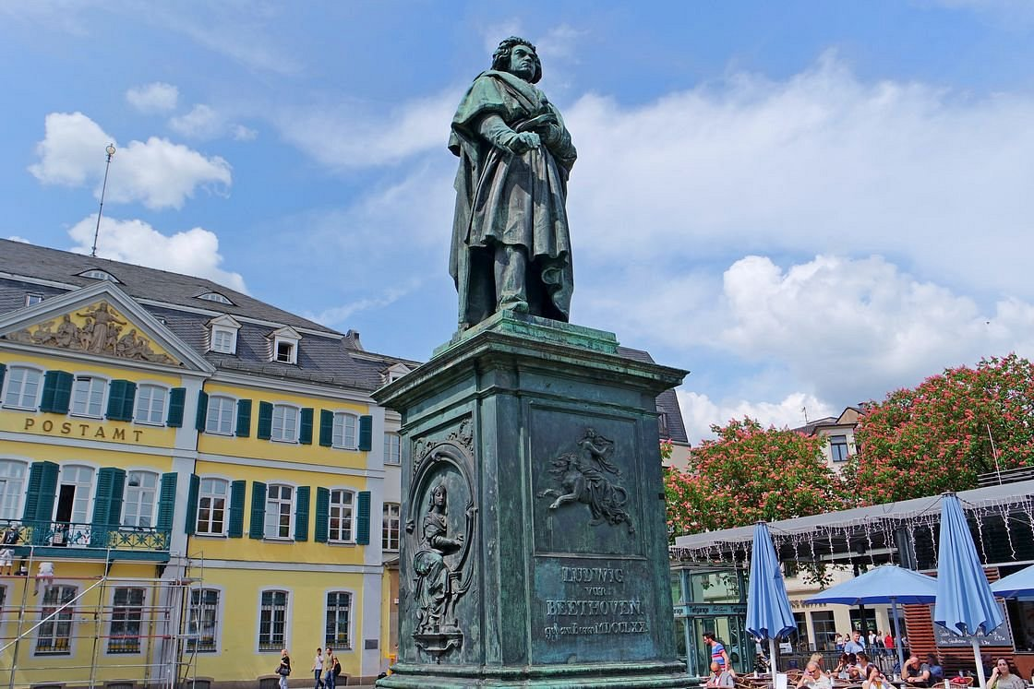
Hobbies
In my free time, I enjoy:
Reading.
Travel to new places and experience different cultures.
stay active with sports.
big fan of music.
https://meiner.de/kritik-der-reinen-vernunft-8811.html

Slide 15
Opportunities:
Expectation:
Can you tell me about the training and development opportunities that are available at Fraunhofer IAIS? I'm interested in furthering my professional growth and contributing to the success of the organization.
Could you please provide me with information on the potential for pursuing a PhD while working?

Slide 16
Question & Discussion

Slide 17
Second Part

Slide 18
Introduction of Weather App:
The customer needs a platform-independent, cloud-ready application that downloads weather data for the city of Cologne from an open platform at configurable intervals and writes it to a CSV file.
They require the application to be fault-tolerant and have standard monitoring interfaces, allowing for quick updates.
the deployment and integration should be as simple as possible and based on current standards.
The development and deployment of the solution should be efficient, traceable and quality-assured.

Slide 19

Architecture of Weather App:
Back End
https://www.google.c/url?sa=i&url=https%3A%2F%2Fwww.bezkoder.com%2Freact-node-express-mysql%2F&psig=AOvVaw0JQH4PdWXJHs-2pwgx-0UC&ust=1683056271181000&source=images&cd=vfe&ved=0CBEQjRxqFwoTCMiLw6vv1P4CFQAAAAAdAAAAABAJ
Front end
React
Spring Boot
AXIOS
HTPP
Components
Service
RestControleer
Spring JPA

Slide 20

React.js:
React is mainly used for building user interfaces. it is possible to make HTTP requests to a server or an API to retrieve data and display it in the application.
HTTP requests to the Open-Meteo API to retrieve weather data.
Packages:
Axios: to fetch data from the API.
React-Bootstrap: to build a responsive UI.
Moment.js: to parse and format dates and times.
React-Router-Dom: to create navigation between pages.

Slide 21

User Interface
Cologne city weather
Today
Hourly
Daily
History
Temperature
Wind speed
Rain
Get as CSV
16°
2 KMH
20%
Data Source: https://open-meteo.com/

Slide 22
Pseudocode of React functions
const API_KEY = "your_open_meteo_api_key";
const CITY = "Cologne";
const INTERVAL = 3600000; // 1 hour in milliseconds
const CSV_FILE_NAME = "weather_data.csv";
const response = await axios.get( `https://api.open-meteo.com/v1/forecast?city=${CITY}&key=${API_KEY}` );
saveToCsv(data);

Slide 23

CI/CD & Deployment of Application:
CICD Pipeline with GitlabCI:
GITLab: is a remote server:
.gitlab-ci.yml: is a configuration file used in GitLab to define Continuous Integration/Continuous Deployment (CI/CD) pipelines for a project.
file contains a set of instructions for the GitLab Runner, which is a separate server that is responsible for running the CI/CD pipeline.
file is automatically triggered when changes are pushed to the repository, and it helps to ensure that the code is continuously tested, built, and deployed in a consistent and repeatable manner

Slide 24
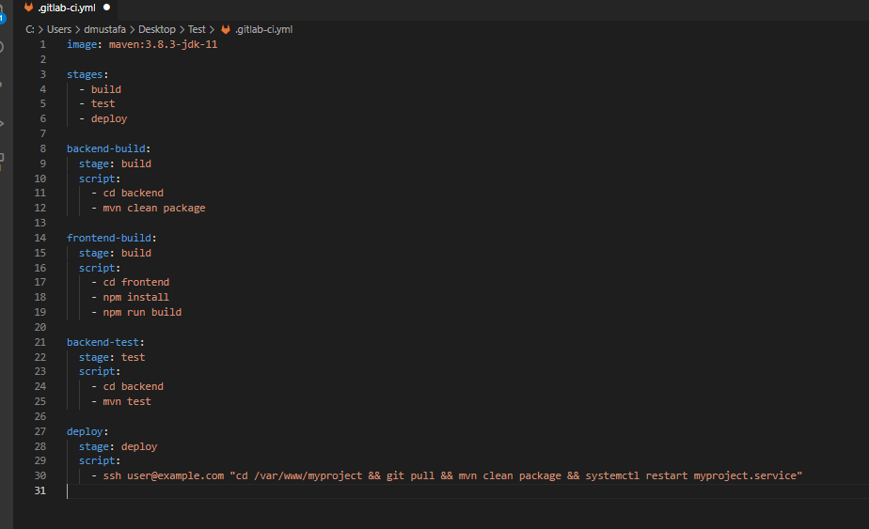
CI/CD & Deployment of Application:
a job to build your Spring Boot backend
job to build your React frontend.
define scripts to run tests
deploy to production.
and more.

Slide 25

CI/CD & Deployment of Application:
Docker Compose:
Use in .gitlab-ci.yml can bring several benefits, including:
Simplify the deployment process.
Consistent environment: define application's dependencies and configuration in a single file.
This ensures that your application runs consistently across different environments, regardless of the underlying host system.

Slide 26
CI/CD & Deployment of Application:
Docker Compose:
Isolation: Using Docker Compose allows you to isolate your application from the host system, reducing the risk of conflicts with other applications or dependencies on the host system.
Scalability: Docker Compose makes it easy to scale your application horizontally by defining the number of containers for each service in your application

Slide 27
Cloud ready solution:
Cloud Service:
application or system that is designed and optimized to run in a cloud environment.
It is built to take advantage of the benefits of cloud computing, such as scalability, flexibility, and cost-effectiveness.
A cloud-ready solution can be deployed on various cloud platforms. Amazon Web Services (AWS). Microsoft Azure, and Google Cloud Platform.
without significant modifications to its architecture or code.

Slide 28
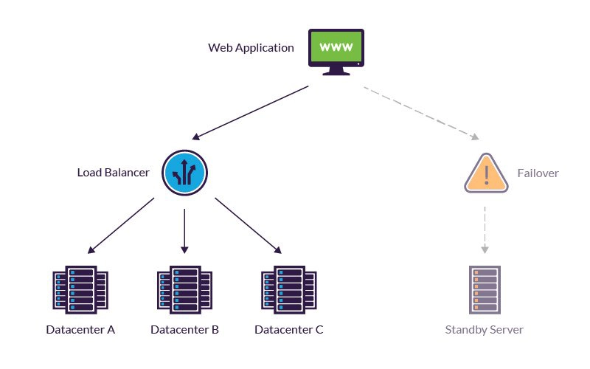
Fault tolerance:
- to continue operating without interruption when one or more of its components fail.
- Fault tolerance relates to the use of load balancing and failover solutions to ensure availability via redundancy.
Use microservices architecture, containerization or other methods to ensure high availability.
AWS cloud.

Slide 29
Standard interfaces for monitoring:
Implement standard interfaces for monitoring, such as logging, metrics, and health checks. we can use open-source tools like Prometheus, Grafana, and ELK stack.

Slide 30
Question & Discussion

